Slide 1
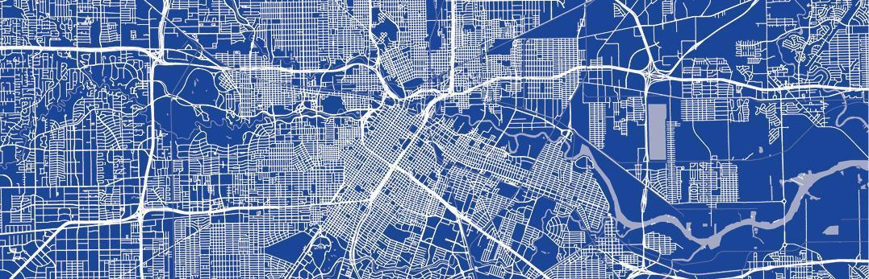

The Livable Places Initiative
Super Neighborhood Alliance
June 2023

Slide 2
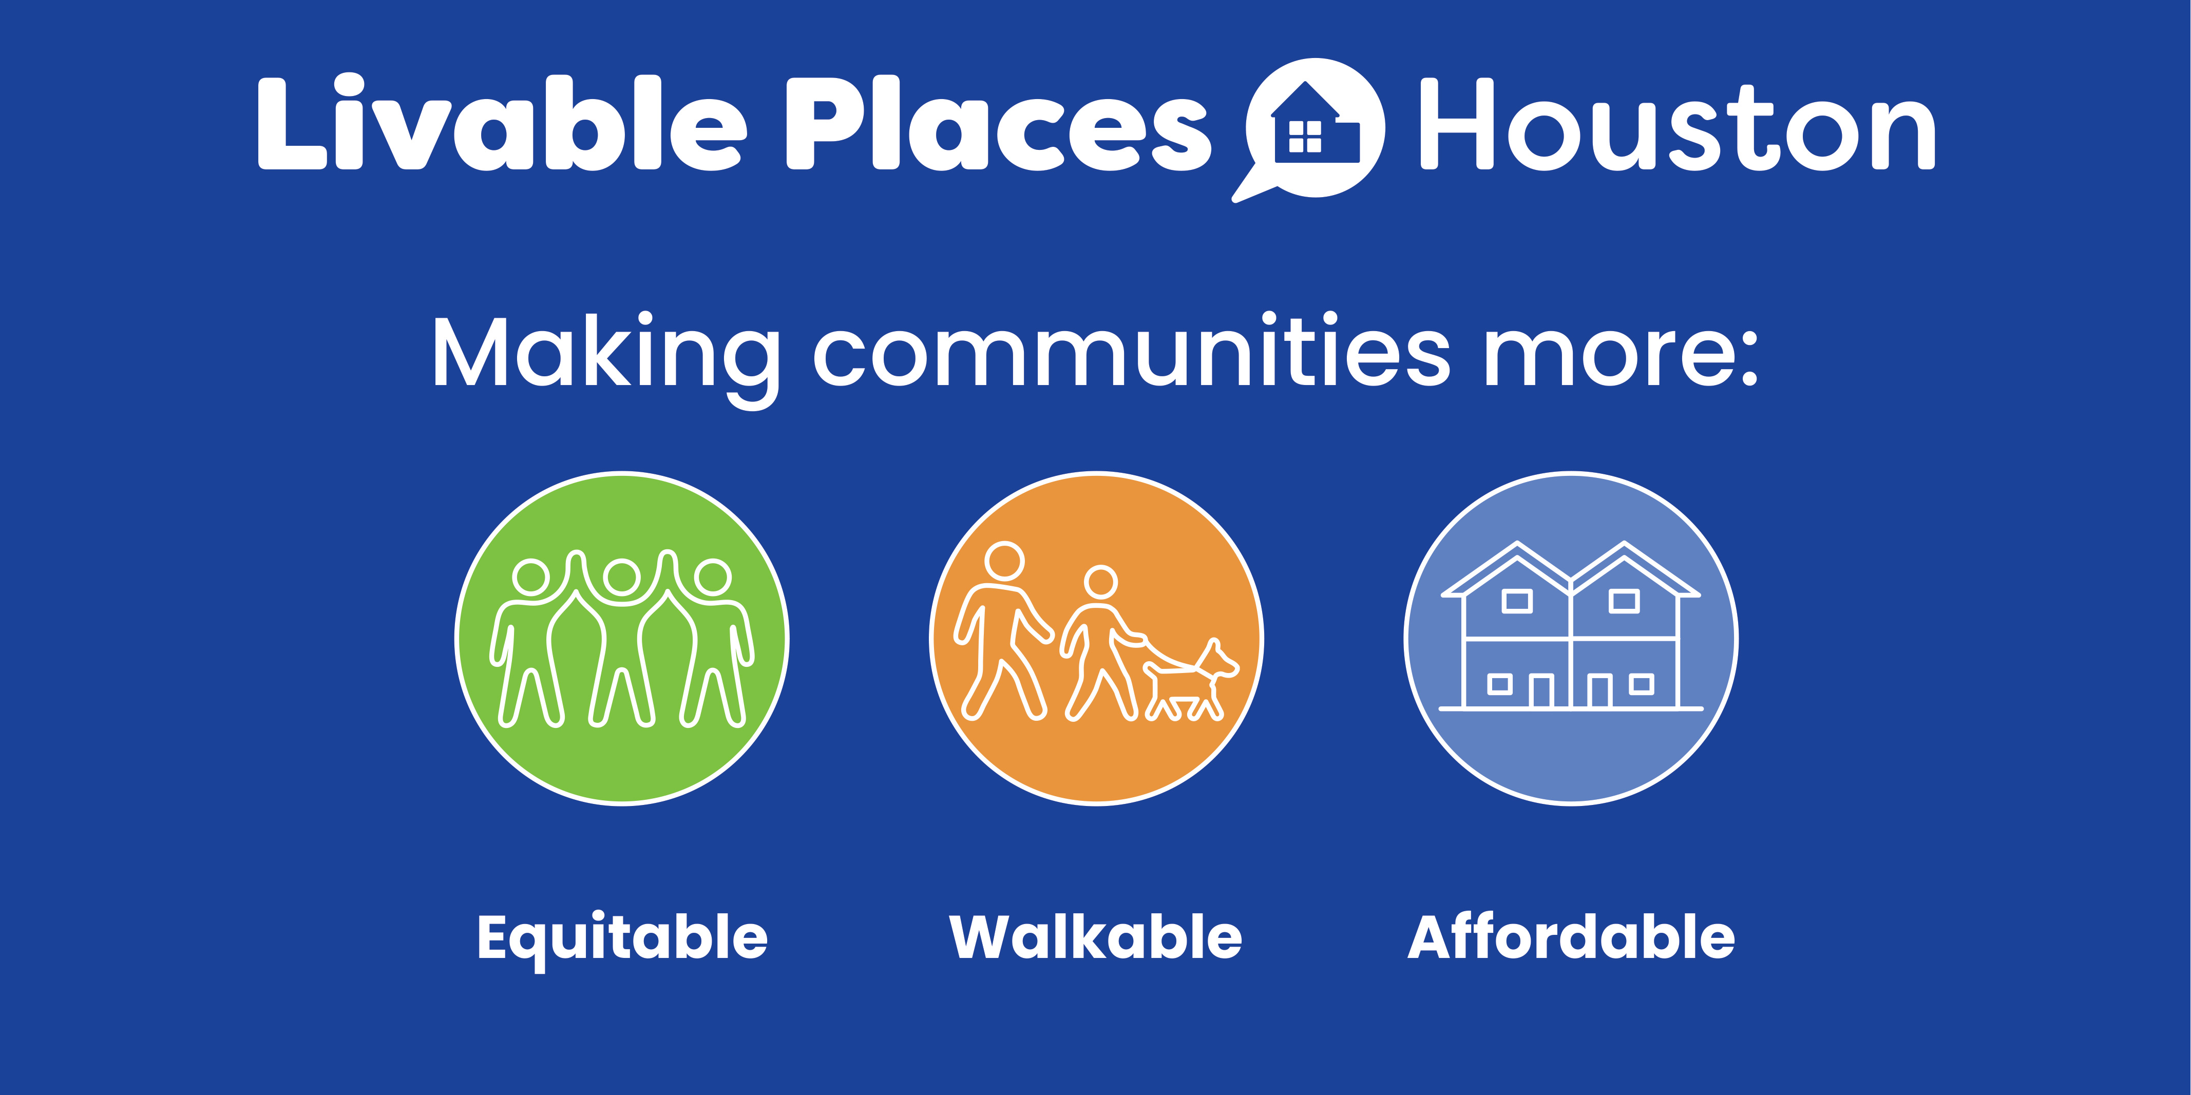
2
Notes:
Thank you for letting me speak to you again tonight. Many of you have been involved in our Livable Places Action Committee work for the past three years and we are grateful for the contributions you made. I am here to update you on the Planning Commission actions last week and where we are going from here.
I know that Mr. Allen just outlined his opposition to one piece of it – but the Livable Places package is about so much more.
The Livable Places Action Committee recommendations are all about changing our development codes to provide a wider variety of homes to meet the needs of Houstonians. They focus on Affordability, Equity and Walkability.
Livable Places recommendations include all sorts of incentives to help builders build homes that are more aligned with the existing development patterns in your neighborhoods. The recommendations encourage smaller, more neighborhood-friendly homes. They recommend that these homes support existing development patterns and provide for safer pedestrian spaces. The recommend that new development support the neighborhoods in which they are built.

Slide 3
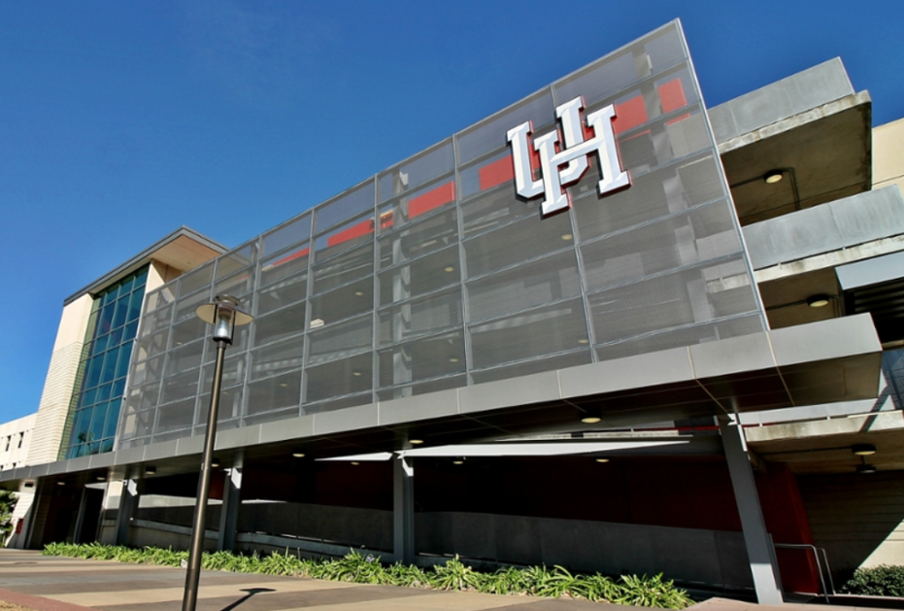
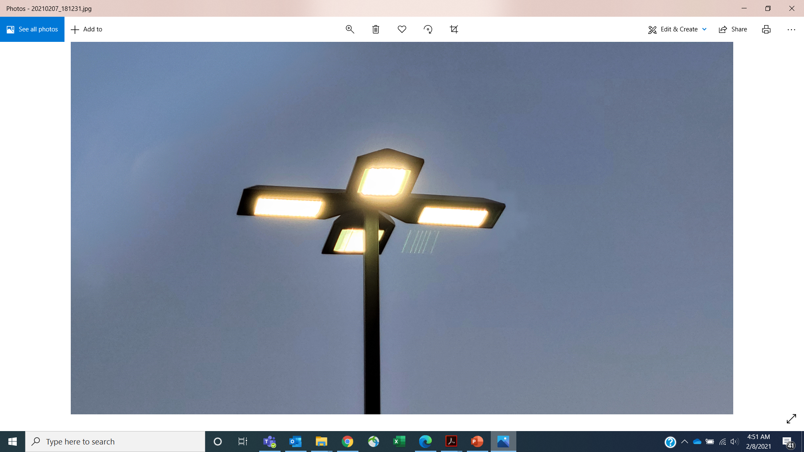

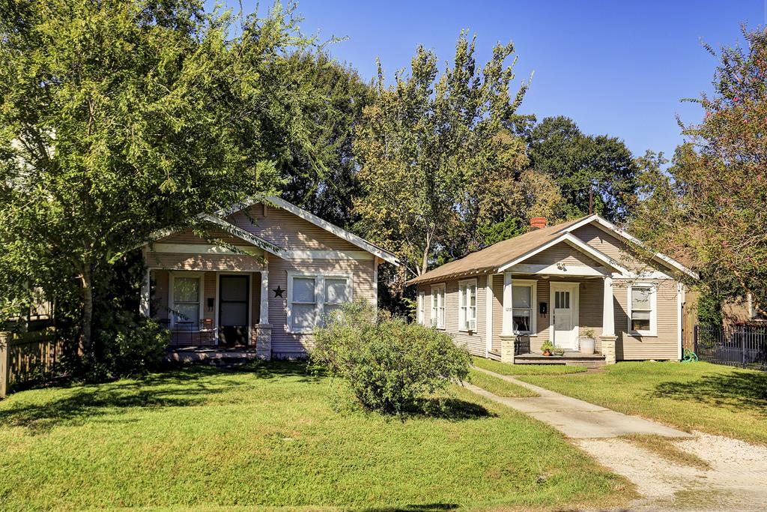
Accomplishments to date:
Effective dates:
Residential Buffering and Screening Feb 27, 2023
Sidewalk Standards and Fee In Lieu Mar 1, 2023
Conservation Districts Apr 5, 2023
Acres Home Magnolia Park/Manchester
Freedmen’s Town Piney Point
Independence Heights Pleasantviille
Notes:
First, let me recap the improvement that have already been accomplished.
In February, we strengthened the Residential Buffering and Screening ordinances. We had heard over the years that those ordinances had gaps where neighborhood leaders didn’t feel that commercial and garage developments were encouraged to be good neighbors. These changes fixed a lot of these problems. They expanded the type of residential development that was protected, they improved lighting requirements so that the lights from parking lots and garages are less likely to shine in your bedrooms; dumpsters located on public streets are now required to have screening so it’s less likely that their overflow will blow away.
In March, City Council revised the sidewalk regulations to fix the requirement that caused those infamous sidewalks to nowhere and created a fund that can build sidewalks where they are truly needed.
Then, in April, City Council created a Conservation District program for six neighborhoods to give the communities the ability to create their own standards that encourage new development to be more sympathetic and aligned with the existing community development patterns.

Slide 4
Proposed Housing Recommendations
4
Notes:
So, what do we have left? The last tranche of recommendations are changes to our residential development standards.

Slide 5
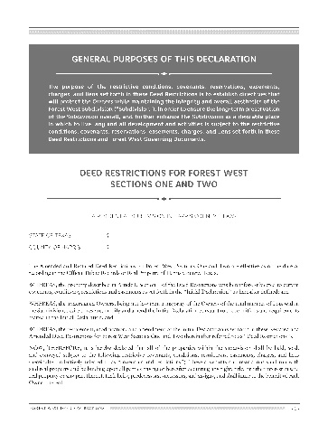
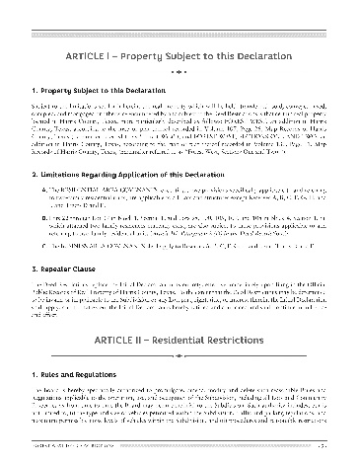
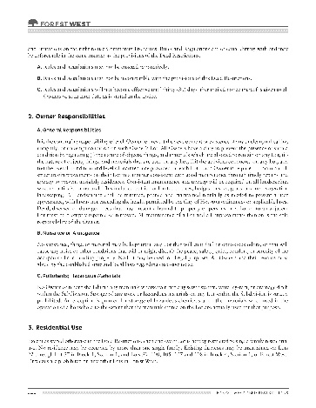
Deed Restrictions Override
The City has no authority to override or supersede active, private deed restrictions.
Any changes to the development code that come out of this effort would
not apply where prohibited by deed restrictions.
Notes:
First, I need to confirm. None of these changes will supersede existing, active deed restrictions. If your deed restrictions prevent any of the development standards I will discuss, then there is nothing the planning department can do to make them happen.

Slide 6
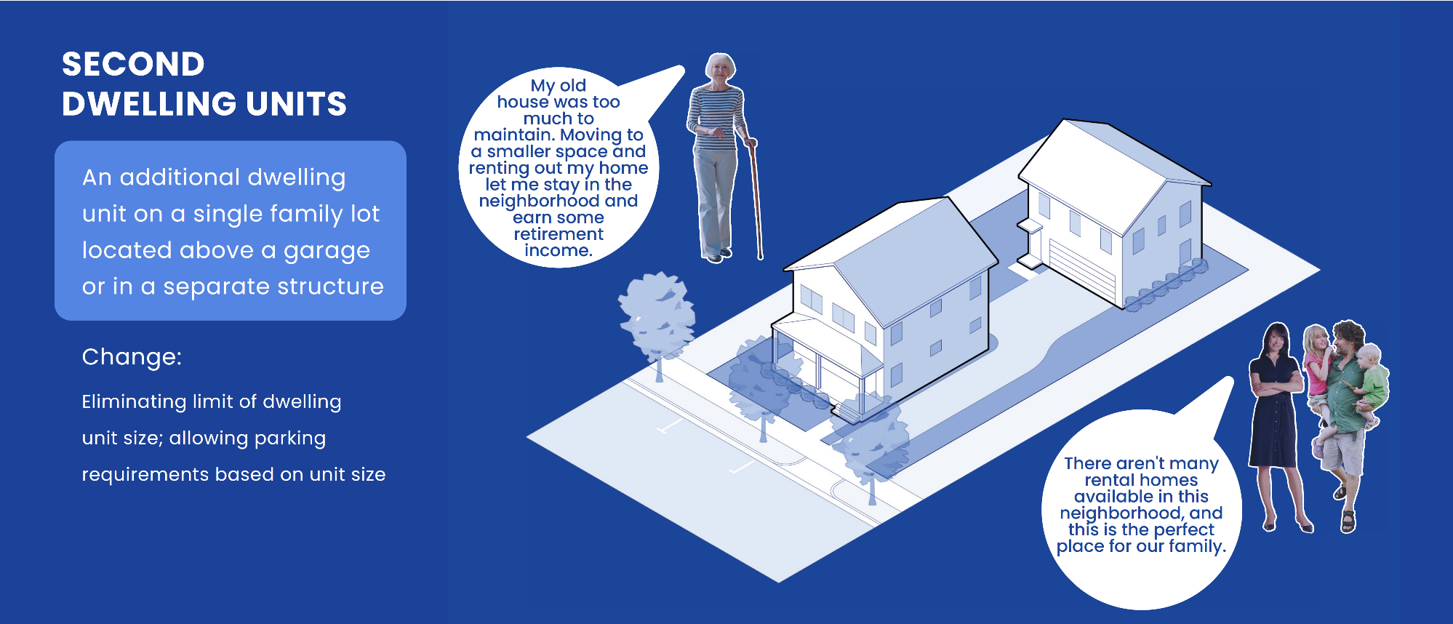
Second Dwelling Units
Increasing the maximum size from 900 SF to 1,500 SF; aligning parking with the size of the unit
Notes:
First, it’s about making it easier for you to build a garage apartment or an accessory dwelling unit. Maybe it’s a first home for your children as they move out of your house. Maybe it’s a safe place for your parents to come to when they need just a little bit more attention. Or, maybe it’s just an opportunity for you to earn more income, whatever the reason, these rules make it easier for you to build a garage apartment or a granny flat.

Slide 7
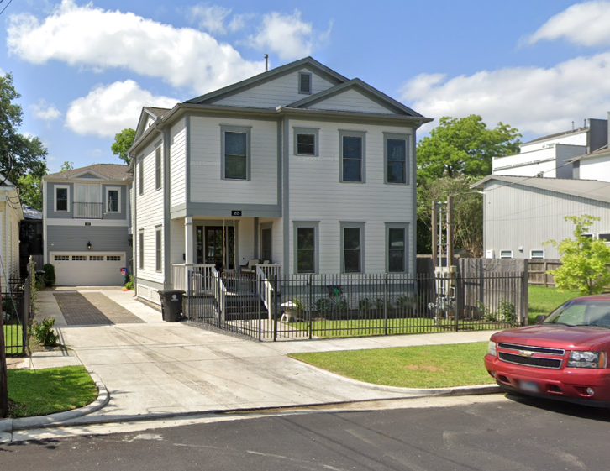
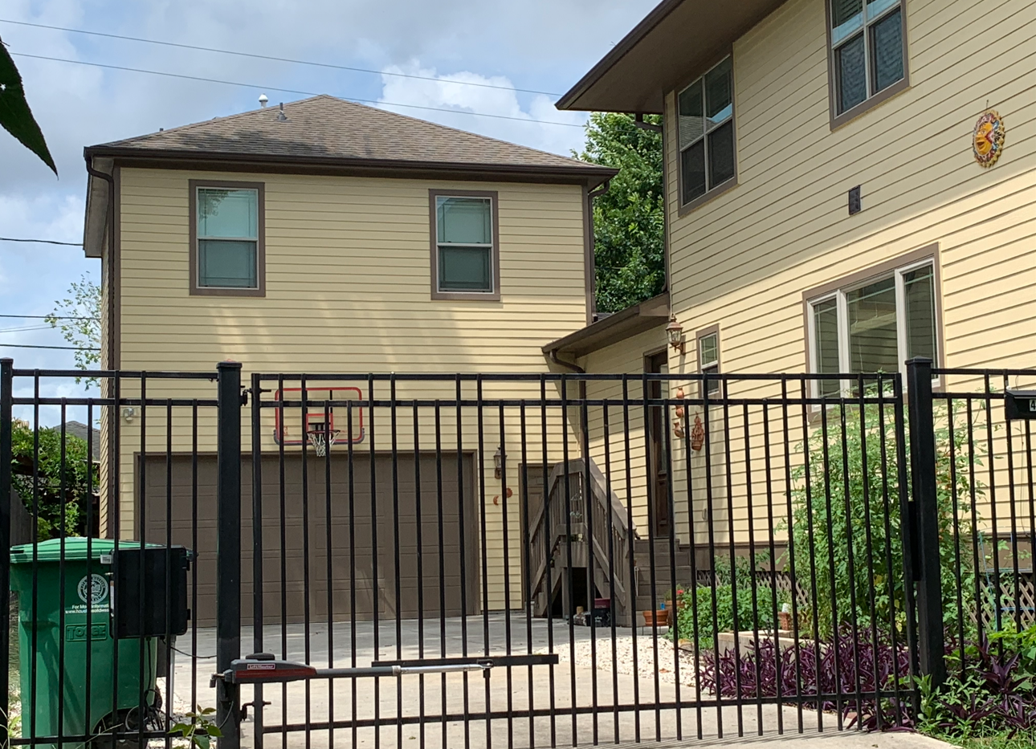
What We Would Like – Second Dwelling Units
Notes:
If you remember, we originally recommended there be no maximum limit on an ADU’s size. When we talked to you about it, we heard loud and clear that you thought there needed to be a limit – maybe 1,500 SF, and so the Planning Department changed its recommendation to have a maximum size of 1,500 square feet. Since ADUs must conform to all setback and drainage considerations, the size of the lot and the existing home will greatly dictate whether ADUs can even approach this size.

Slide 8
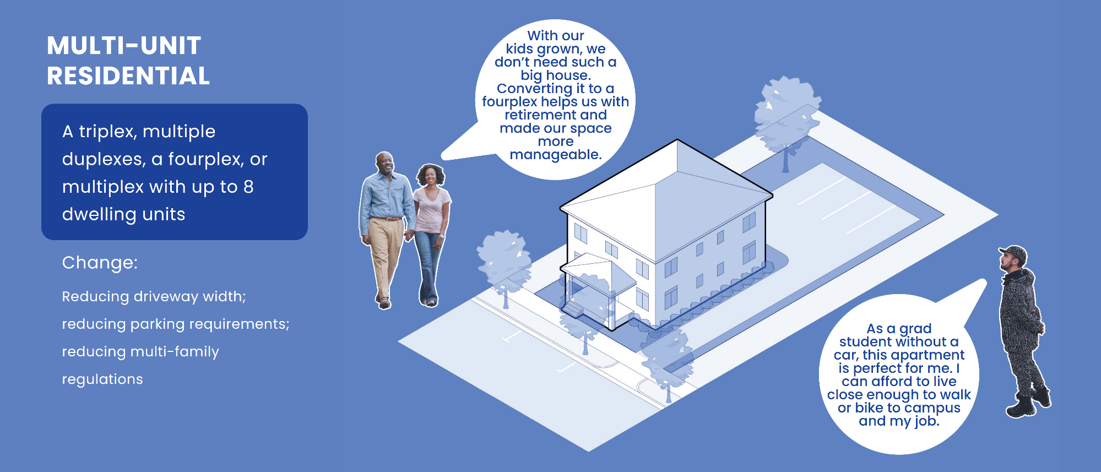
Return of the Fourplex
Reduce driveway width; aligning parking to the size of the unit; allowing 3--4 units on local streets; limiting 5--8 units to collectors and major thoroughfares.
Notes:
The second change we’re making is to make it easier for people to build triplexes or four-plexes up to eight units of apartments in and around neighborhoods. This type of home was prevalent in Houston, but our rules have changed, and it has become nearly impossible to build or repair them. Right now, a fourplex has the same requirements as a larger development of hundreds of apartments.
When we first proposed this, we proposed that these small-scale apartments – up to 8 units- could be built in neighborhood streets. But, again, you told us that you didn’t want larger buildings in your neighborhood and so, with your suggestions, we adjusted our recommendation to allowing triplexes and quads on local streets and limit larger units to more commercial streets – those classified as collectors and major thoroughfares.
Also, when we originally proposed these, we proposed one parking space for every 1,500 – but based on your comments, we reduced to one space for every 1,000SF and added 2 spaces for units over 1,000.

Slide 9
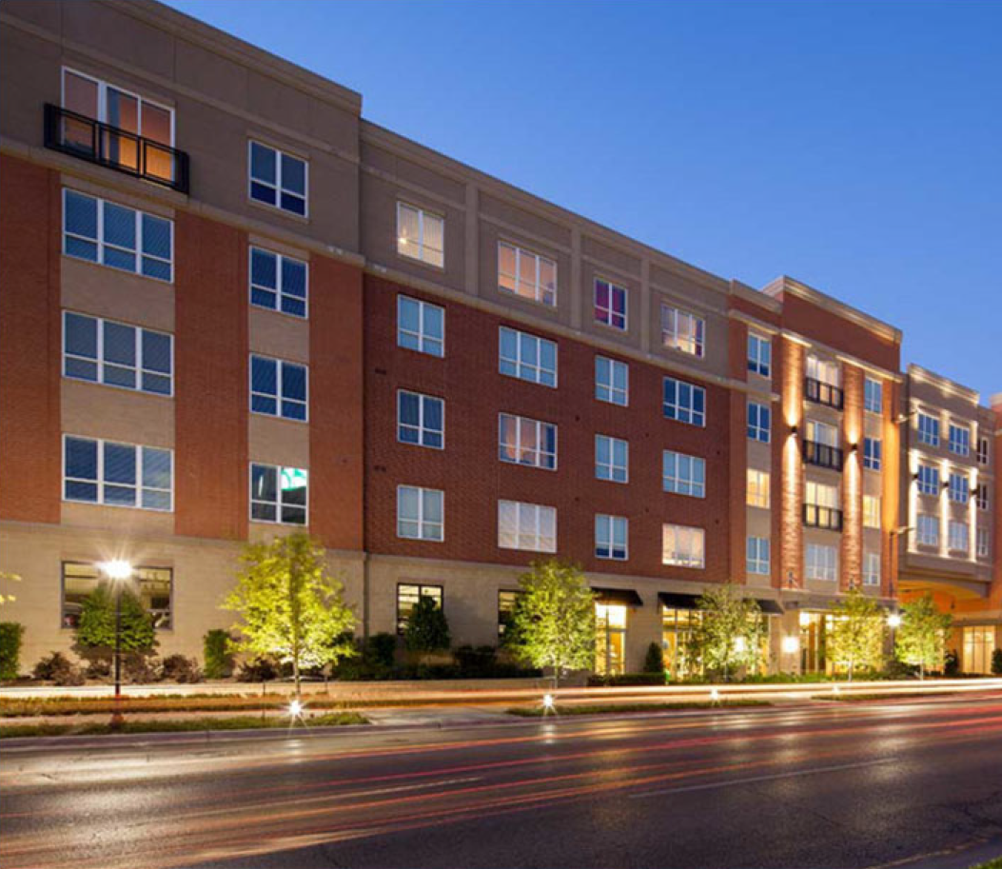
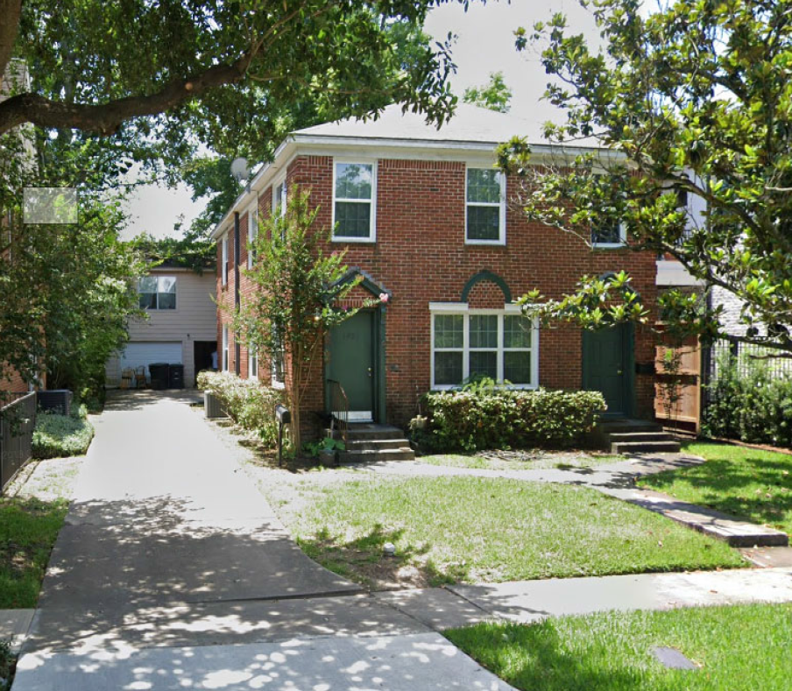
From This to That – Multi-Unit Residential
What we have now
What we would like
Notes:
We believe that these small buildings will be more neighborhood friendly and provide an alternative to the five story apartment complexes we see some much of. This is a way to bring more Houstonians into your area in a way that is friendly to the development styles that are already there.
Reintroducing this type of housing can help retain the feel of existing neighborhoods while providing more affordable housing options.

Slide 10
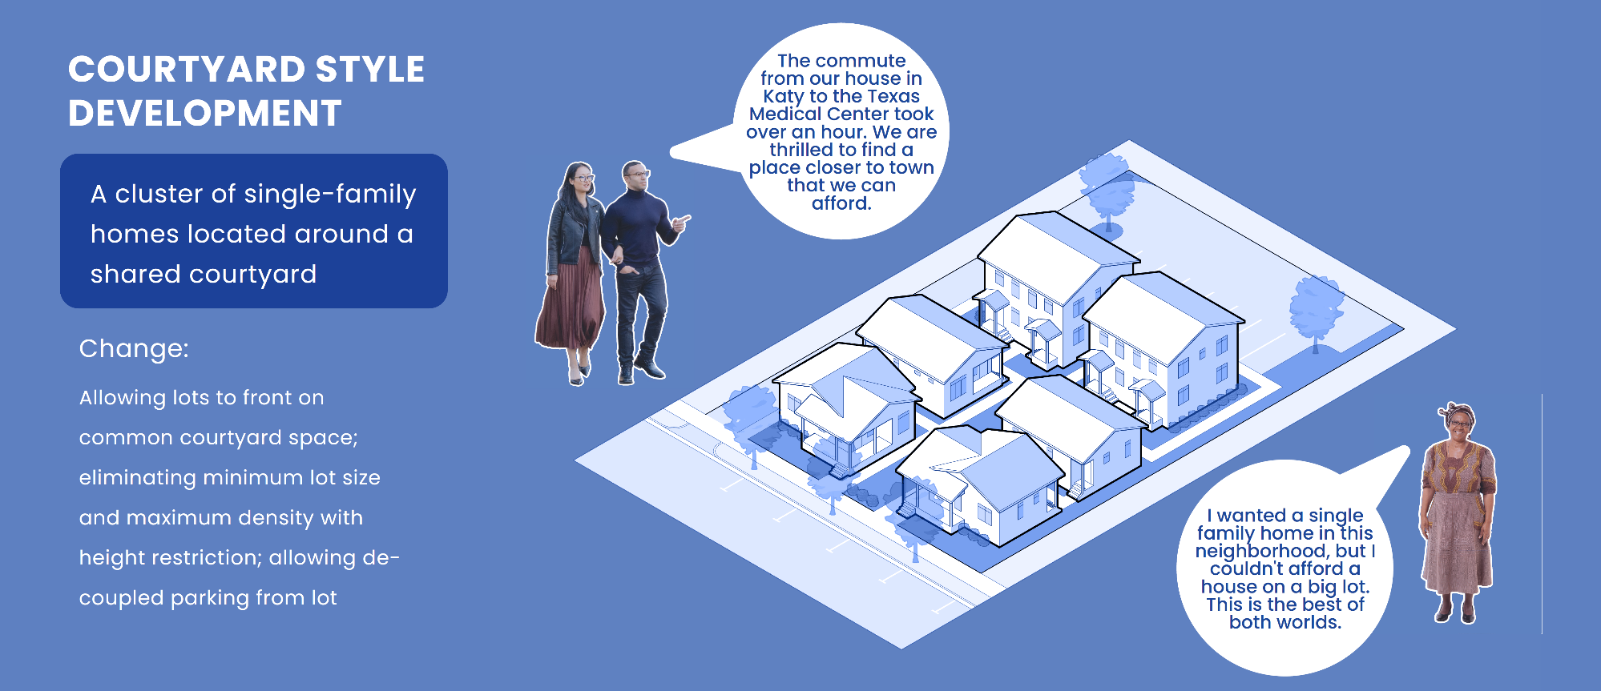
Courtyards Create Community Spaces
Allowing units to front on common green space; no minimum lot size or maximum density; setting height restrictions; decoupling units from parking; establishing maximum unit size of 1,800 SF
Notes:
Third, we’re creating a new type of development for Houston we’re calling Courtyard Development. We’ve heard a lot of excitement about this style. It allows for Houstonians to buy smaller homes on smaller lots - as long as the home is built along a common green space or a courtyard. These will have a maximum height and a maximum size, so they’ll fit right in alongside neighborhoods.
The Planning Commission made one change to our recommendations. We proposed limiting the size of these homes to 1,500 SF, but the PC opted for slightly larger – 1,800 SF.

Slide 11
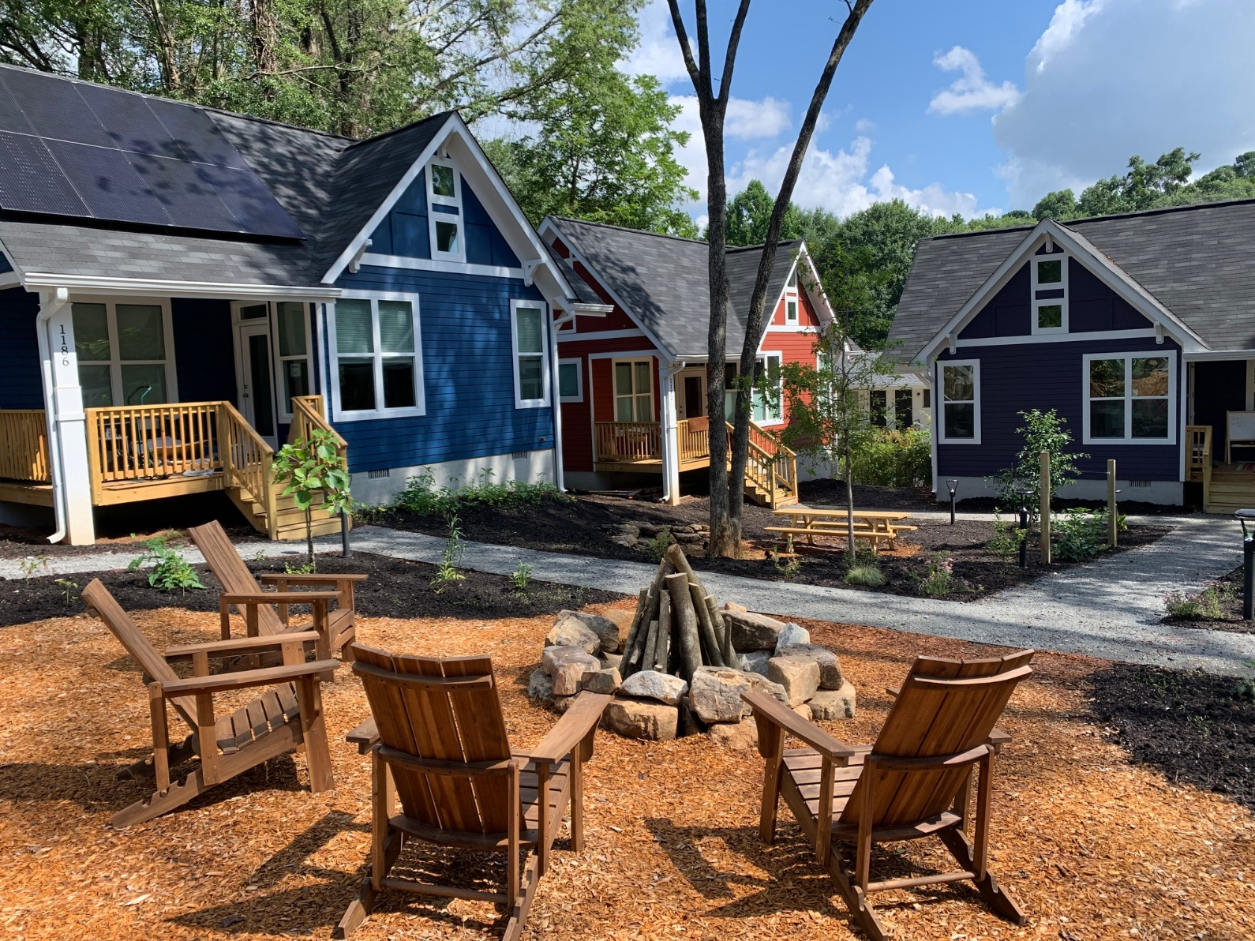
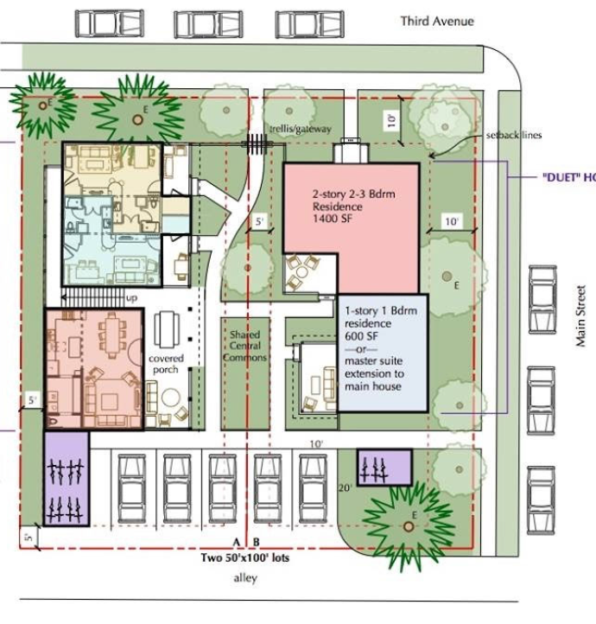
What We Would Like - Courtyard
Notes:
The key to these developments is the greenspace. For each lot created, there must be at least 150 SF of courtyard or greenspace on the property. The other key aspect is that parking is removed from the unit, and this ensures that the ground floor is living space, not a garage.
I recognize that many of you on this call would never consider living in this type of home, but we have many Houstonians who can’t afford larger homes, who don’t need immediate access to their automobile and who are looking for a small home with common greenspace. We have already seen applications for this type of development, just waiting for the rules to officially change.

Slide 12
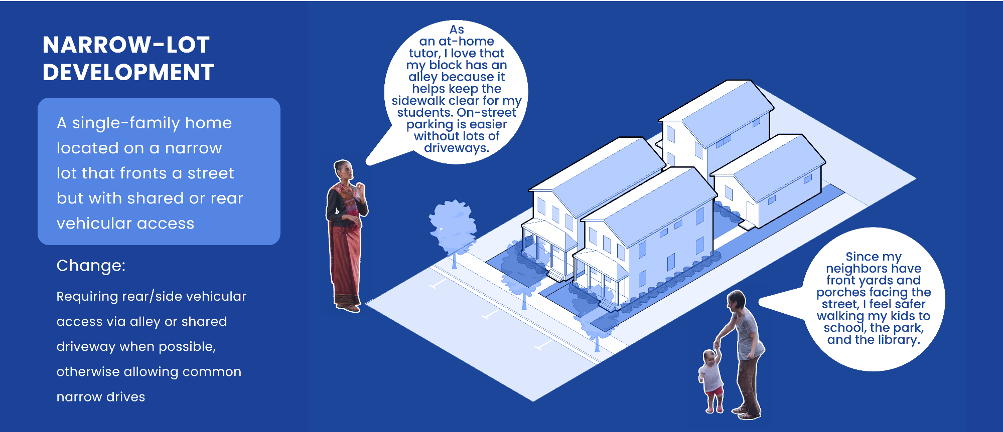
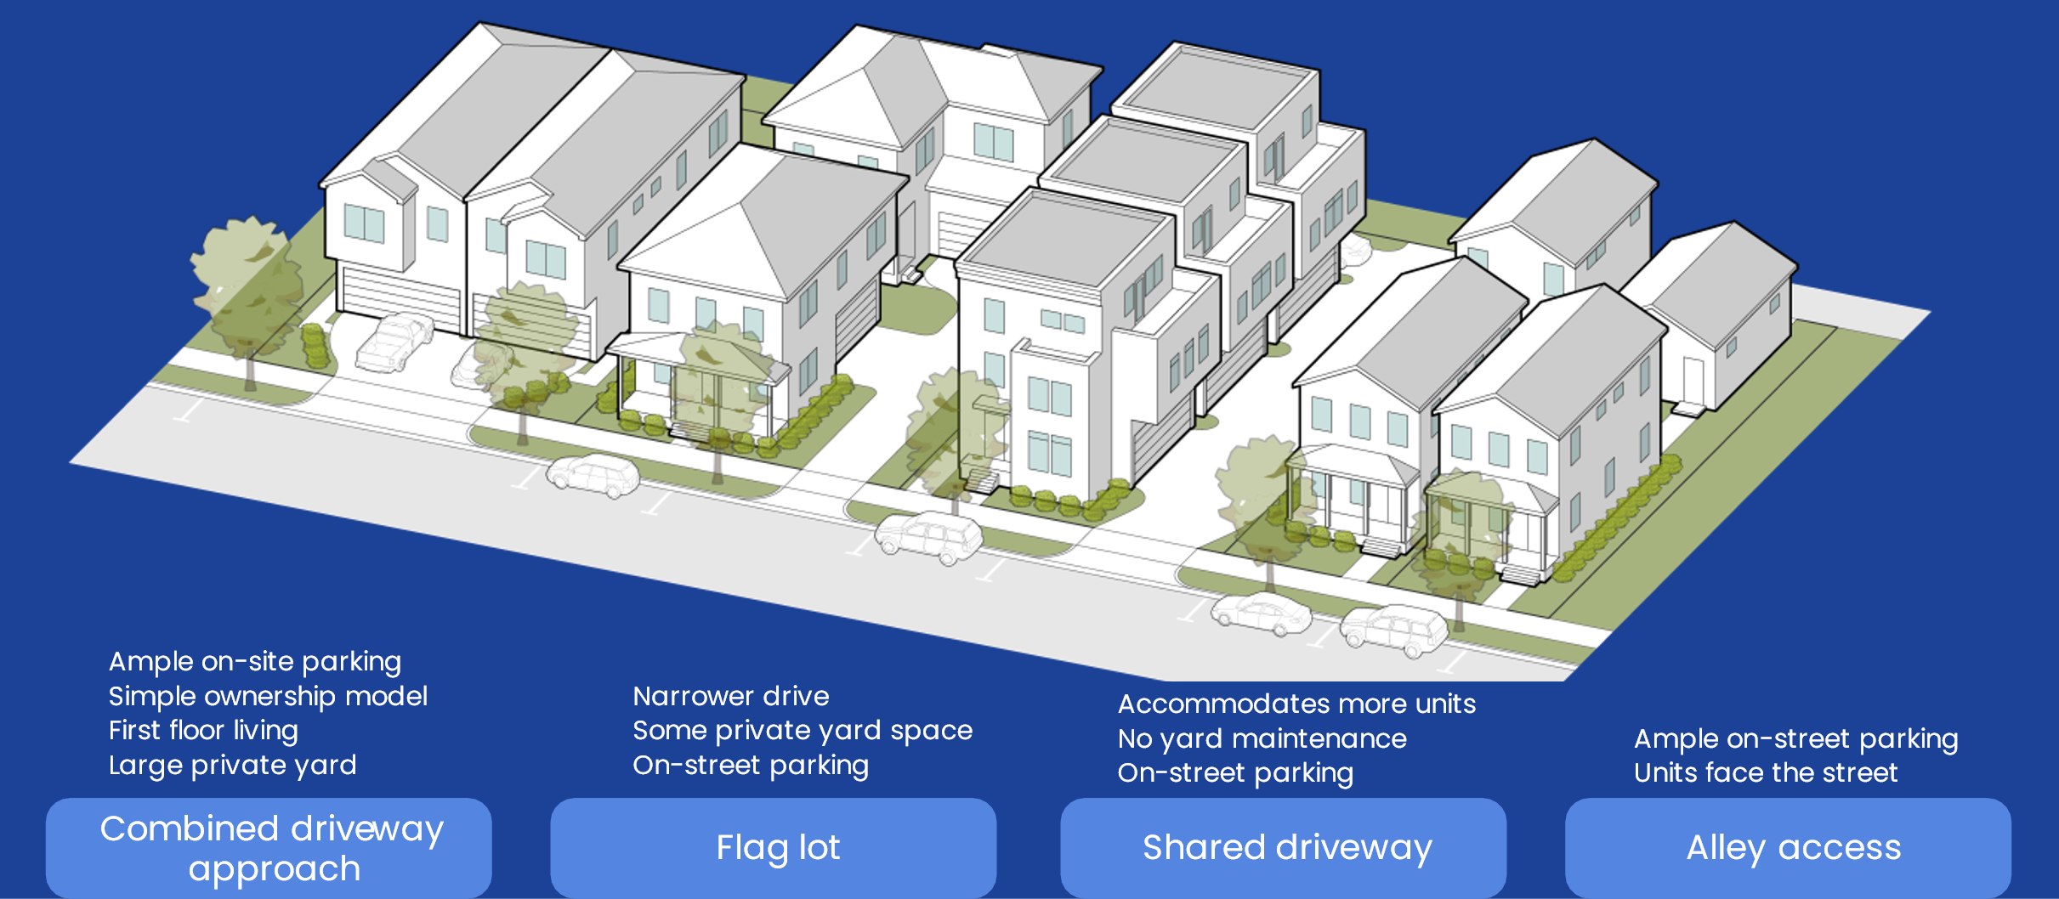
Narrow Lots Can Be Safer
Requiring rear/side vehicular access via alley or shared driveway, when possible, otherwise allowing common narrow drives; no direct front access on lots less than 33’ wide.
Notes:
The last group of changes to the residential development is to improve some of the development that many of your neighborhoods are already experiencing. You know what I’m talking about – when a lot in an existing neighborhood is subdivided and now there are three or four homes where one used to be.
Don’t get me wrong, the Planning Commission and I support infill development and the construction of more homes. There is no doubt, Houston needs more homes for our residents. All we are doing is making some changes that will require these new homes to be more respectful of the street on which its built. Maybe your street.
These changes will encourage the use of rear and side driveways, which will leave the front of the lot more accessible and the sidewalk more useable by everyone. We’re requiring doors and windows on the front, so it provides a more neighborly facade.

Slide 13
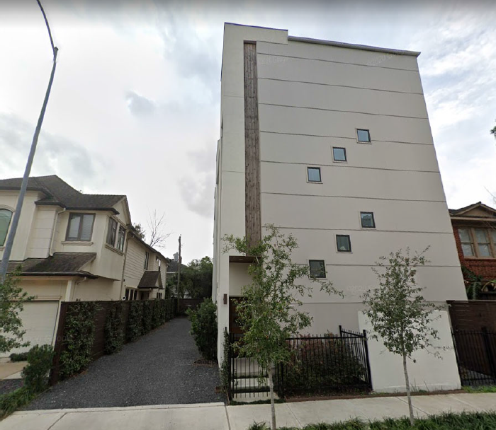
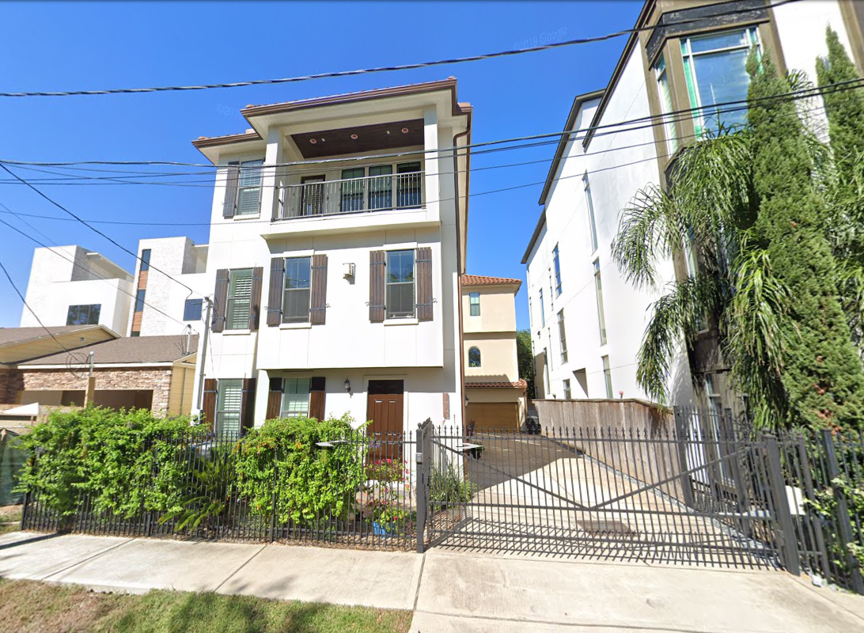
From This to That – Narrow Lots
What we have now
What we would like
Notes:
We will see more of the right, instead of the left.

Slide 14
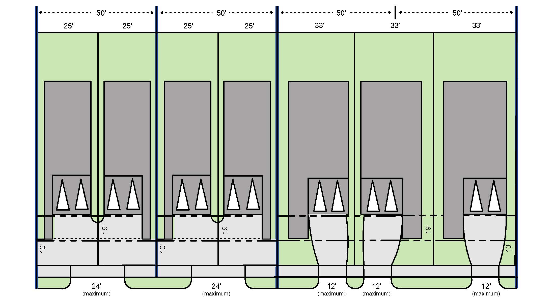
Planning Commission Decision
Notes:
We had originally proposed changing the front-loading access to a tandem approach with a 24’ wide driveway approach.
Specifically, the Planning Commission voted last week to disallow front access to lots that are less than 33’ wide. Lots less than 33’ must use a shared driveway, alley, rear, flag or Permanent Access Easement.
No longer will homes be able to use the entire right-of-way – your right-of-way – as a driveway to one home.
As you heard previously from Mr. Allen, this is the primary issue on which the Builder community disagrees with the package. They believe they should have unfettered access to the right-of-way and be able to build a driveway the full width of the home. We disagree.

Slide 15
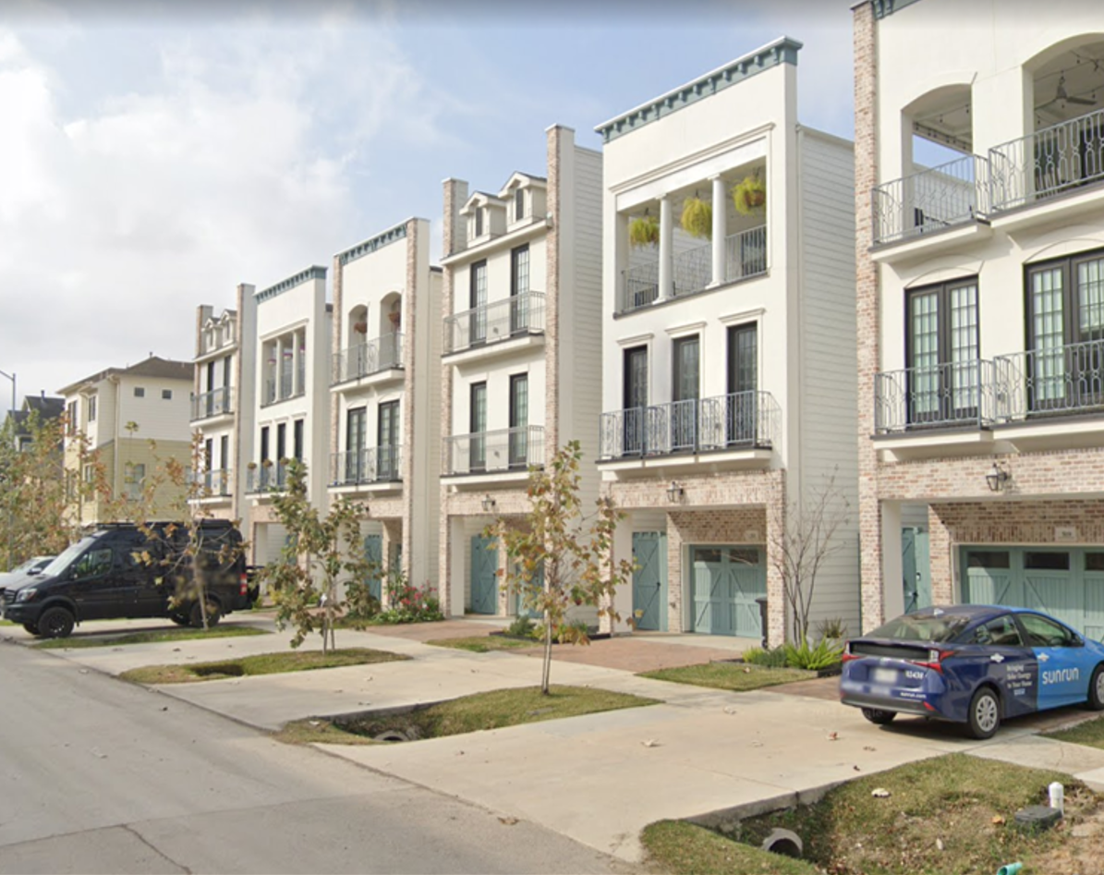
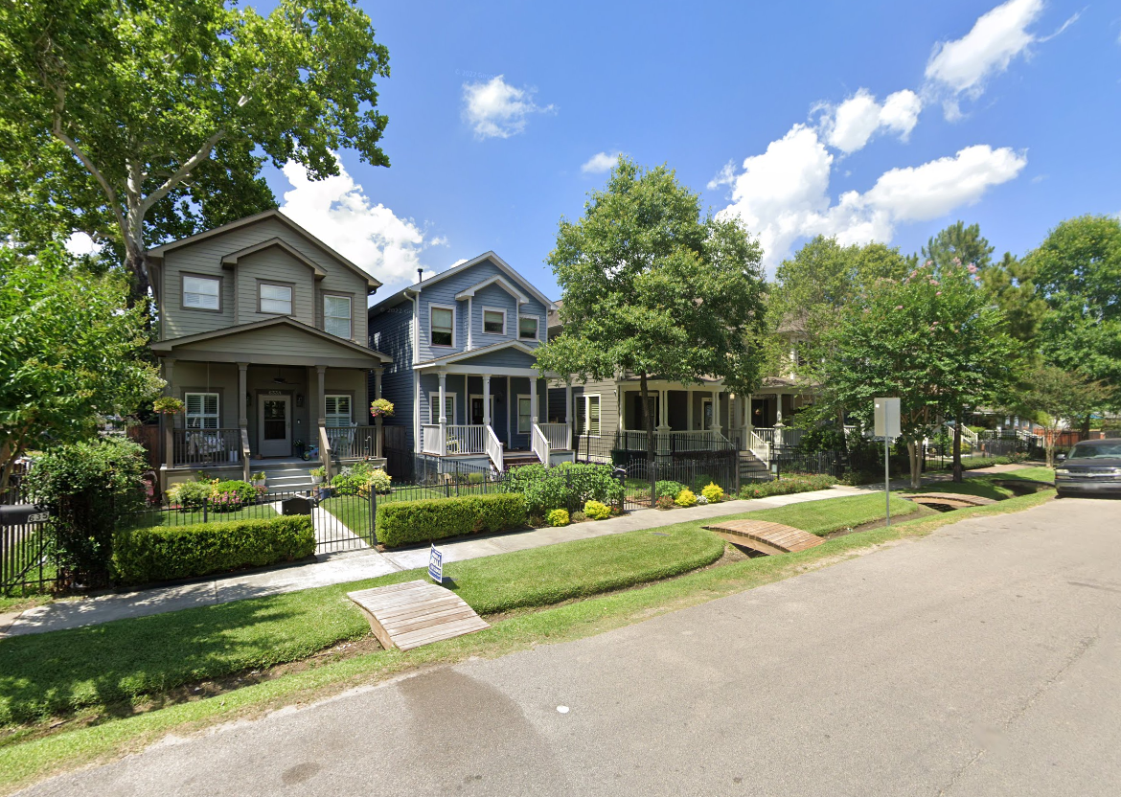
From This to That – Narrow Lots
What we have now
What we would like
Notes:
I know you all have seen this – whole blocks that end up being nothing but driveway after driveway. This will reduce the number of times you have to walk your dog or push a baby carriage down a sidewalk that’s nothing but driveways or, even worse, blocked by a car.
You may have heard that these changes are all about forcing people to park on the street. They are not. These recommendations are laser focused on making the public right of way accessible to the public (you) instead of one homeowner.
We are proposing this change because we believe the public space should be reserved for the public. While every home needs access, it’s not fair for one homeowner to have complete access to so much public space. Not one other person can use this length of driveway. It becomes their private property, and they did not pay for it.
Furthermore, these double wide driveways are unsafe for pedestrians by making them cross over a double-wide space with no refuge. You’ve all experienced how fast someone backs out of their driveway – if it’s only one car wide, that gives pedestrians a fighting chance. But two wide, one right after another, pedestrians are always in jeopardy.
There is no evidence that by limiting the width of these driveways, more people will park on the streets – they do have garages, after all. And if property owners are worried about crime, garages are much safer than either driveways or streets.

Slide 16
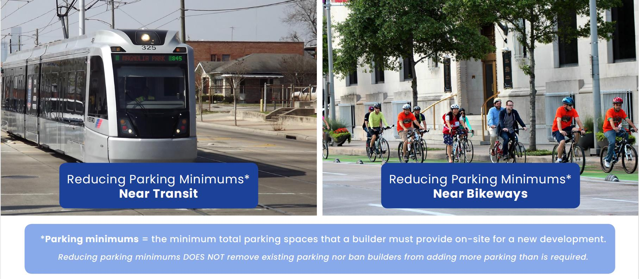
Right-Sized Parking Minimums
Notes:
Ok, so here’s the part of the recommendations that are going to give you a little pause for concern.
The Commission also voted to recommend that, in areas where there are lots of options for using the bus, rail and bicycle – and where there is proof that many people don’t use cars –minimum parking regulations can be eliminated for residential development only. We are not talking about commercial development – just residential. That doesn’t mean that people can’t build parking, it just means that the City won’t require it. Parking will still be built, but it will be tailored to the customers’ needs.
Parking is expensive to build. It requires land that can be better used as a house – one two-car garage could be someone’s home – and in areas of town where people have many other options and don’t use, or can’t afford a car, it makes sense to allow that land to house someone. Not all of Houston, just certain “transit-rich” areas.

Slide 17
PROPOSED MARKET-BASED PARKING NEAR TRANSIT
Notes:
Here is a map showing where the recommendations include. The area is defined by:
¼ mile walking distance from Blue Route Bus Stops in Opportunity Zones where more than 25% of the households have no vehicle;
¼ mile walking distance from Existing Protected Bikeways that are not more than 2 miles from another Protected Bikeway;
¼ mile walking distance from Bus Stops with 15-minute headway; or
½ mile walking distance from BRT/LRT Stations.
If you’ve seen this map before you will recognize a gigantic difference in the amount of blue. Based on what we heard from you, we significantly reduced the distances that trigger market-based parking.
This new map can be found on our livable places page on Let’s talk Houston.org. You can zoom in to see your neighborhood or your home.

Slide 18
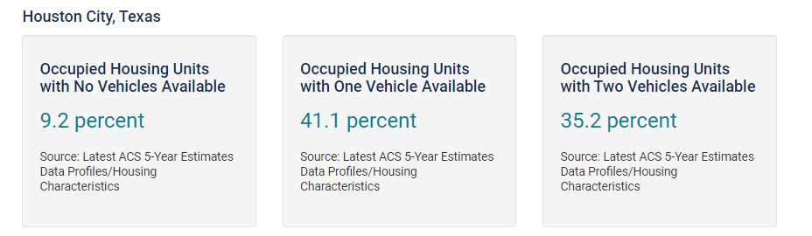
PROPOSED MARKET-BASED PARKING NEAR TRANSIT
Notes:
Now, I know many of you think this is folly. I’ve heard from lots of neighborhoods that cars are needed by everyone for everyday activities and as much as I want it, Houston is not a walkable city.
That’s simply not true. Nearly 10% of Houston households don’t have a car – and another 41% have only 1 car. Yet every single-family home built in Houston requires two spaces. That’s effectively half of all households having less than 2 cars. Not all Houstonians need, or can afford, the second space.
I know this is a lot to digest. Perhaps you still have questions. If so, please call or email me and let’s talk. Go to Let’s Talk Houston.org and leave your comments and questions. We want to hear from you.

Slide 19
Thank You

